Slide 1
CORE JAVA DAY14
NEEHARIKA

Slide 2
Java Lambda Expressions
The Lambda expression is used to provide the implementation of an interface which has functional interface. It saves a lot of code. In case of lambda expression, we don't need to define the method again for providing the implementation. Here, we just write the implementation code.

Slide 3
Why use Lambda Expression
To provide the implementation of Functional interface.
Less coding.

Slide 4

Java Lambda Expression Syntax

Slide 5
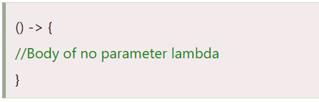
No Parameter Syntax

Slide 6
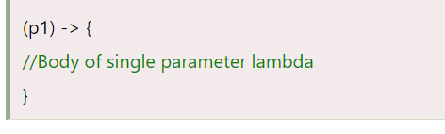
One Parameter Syntax

Slide 7
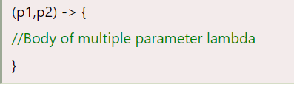
Two Parameter Syntax

Slide 8
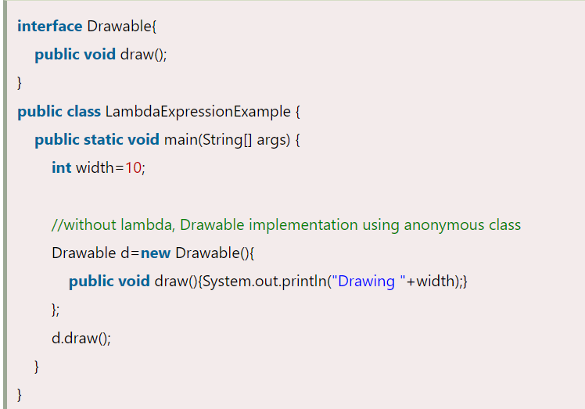
Without Lambda Expression

Slide 9
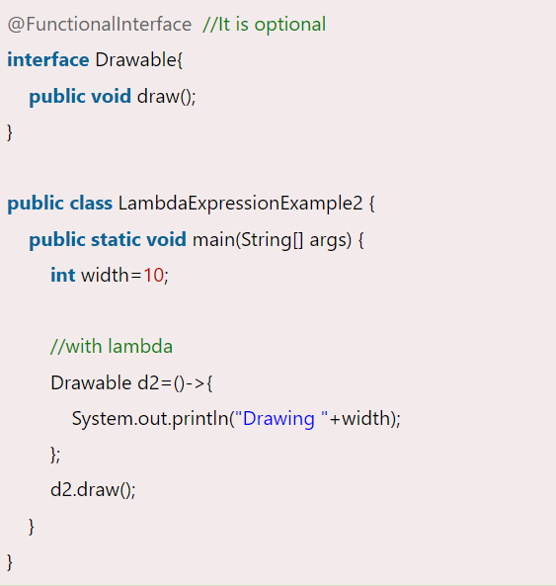
Java Lambda Expression Example

Slide 10
Java Functional Interfaces
Functional Interface is also known as Single Abstract Method Interfaces or SAM Interfaces. It is a new feature in Java, which helps to achieve functional programming approach.

Slide 11
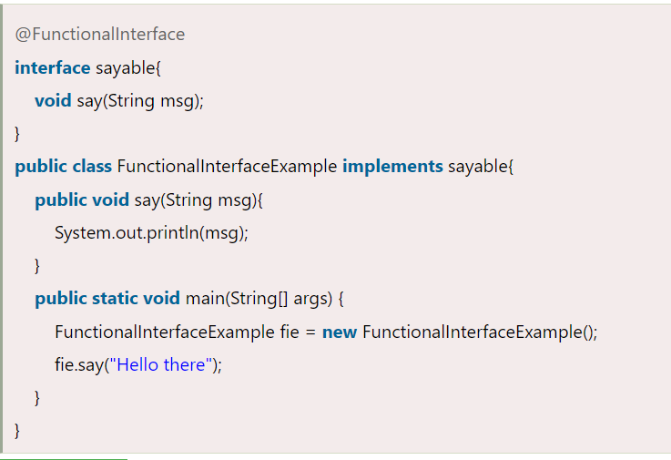

Slide 12
Java Predefined-Functional Interfaces

Slide 13
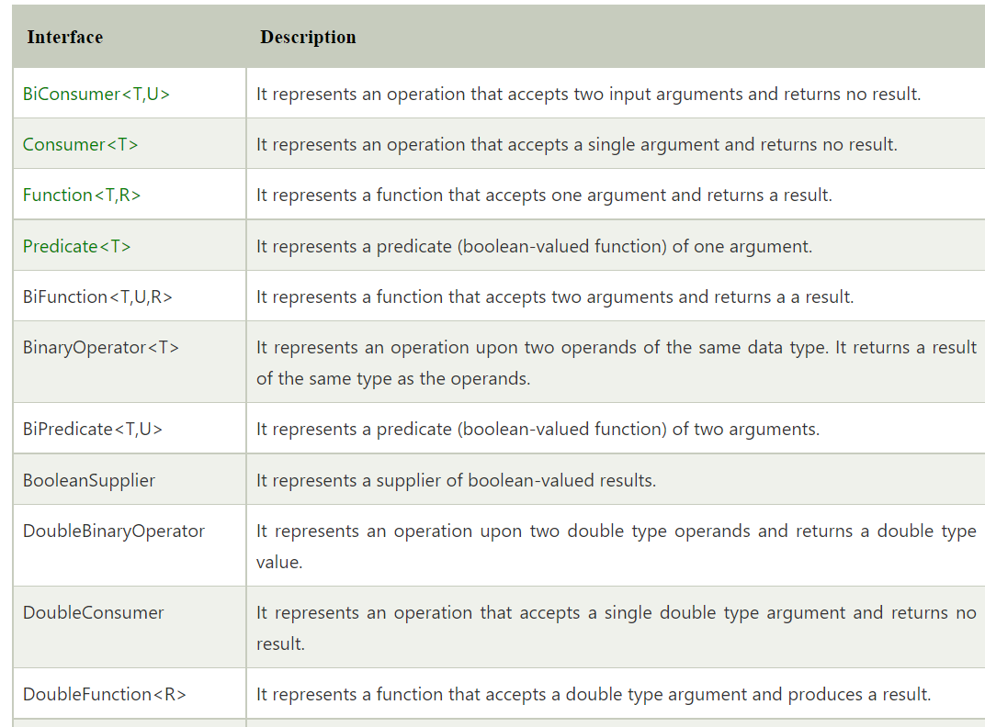

Slide 14
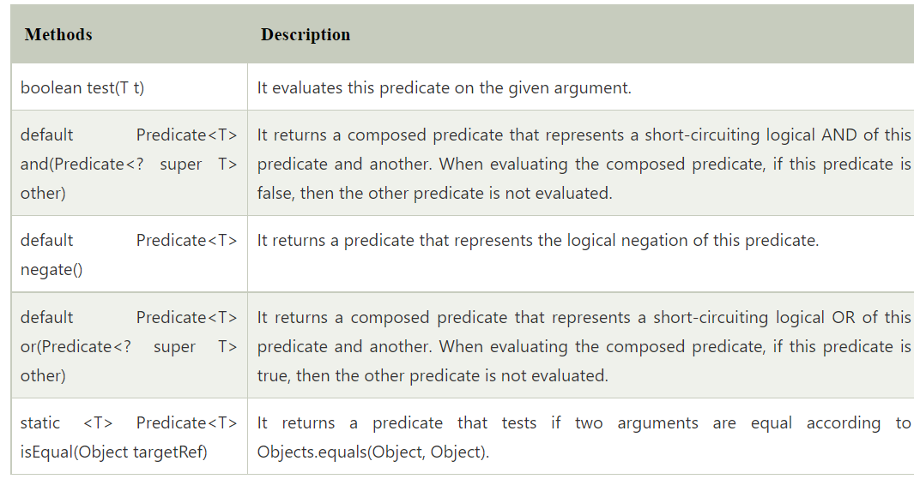
Java Predicate Interface

Slide 15
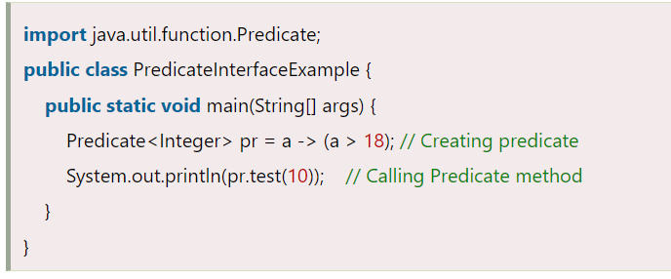
Java Predicate Interface Example

Slide 16
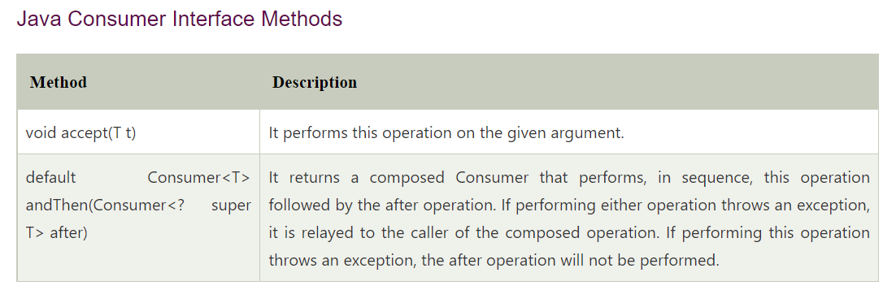
Java Consumer Interface

Slide 17
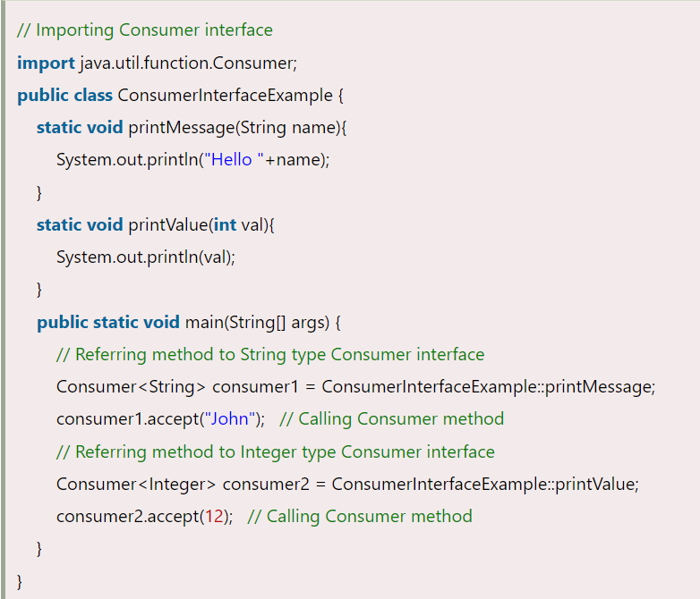
Java Consumer Interface Example

Slide 18
What is primitive specialization?
In java, primitives cannot be given to type arguments such as T, R of R apply (T t) of Function \ <T, R>. In functional interfaces and Streams, some classes are individually defined so that int, long, and double can be operated like generics (without boxing in the wrapper class). This is called a type with primitive specialization. If you remember only int, there is no difference between long and double.
Organize functional interfaces

Slide 19
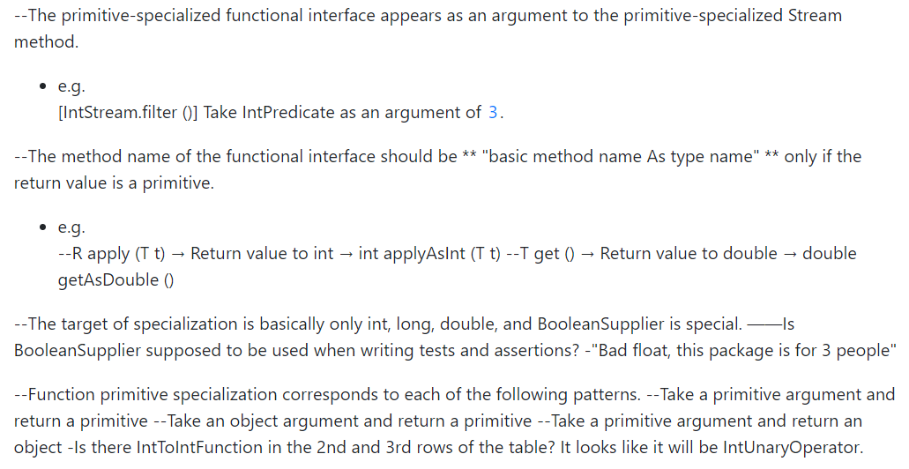

Slide 20
Organize primitive specializations in type
IntStream
LongStream
DoubleStream

Slide 21
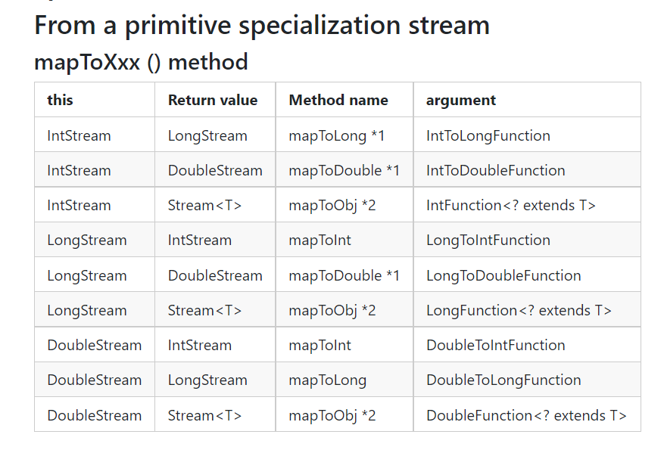

Slide 22
Java Default Methods
Methods which are defined inside the interface and tagged with default are known as default methods. These methods are non-abstract methods.

Slide 23
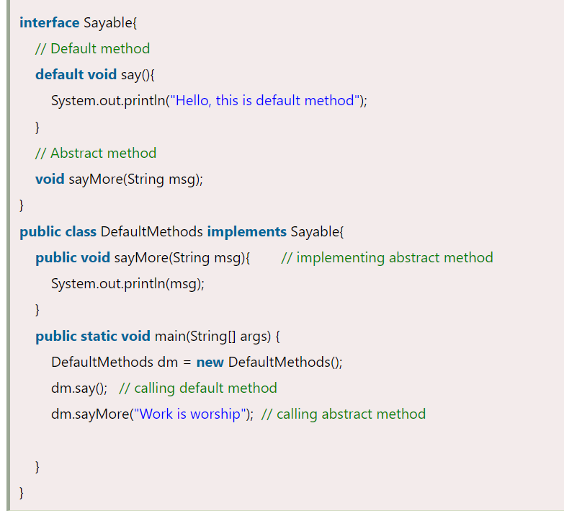
Java Default Method Example

Slide 24
Static Methods inside Java 8 Interface
You can also define static methods inside the interface. Static methods are used to define utility methods

Slide 25
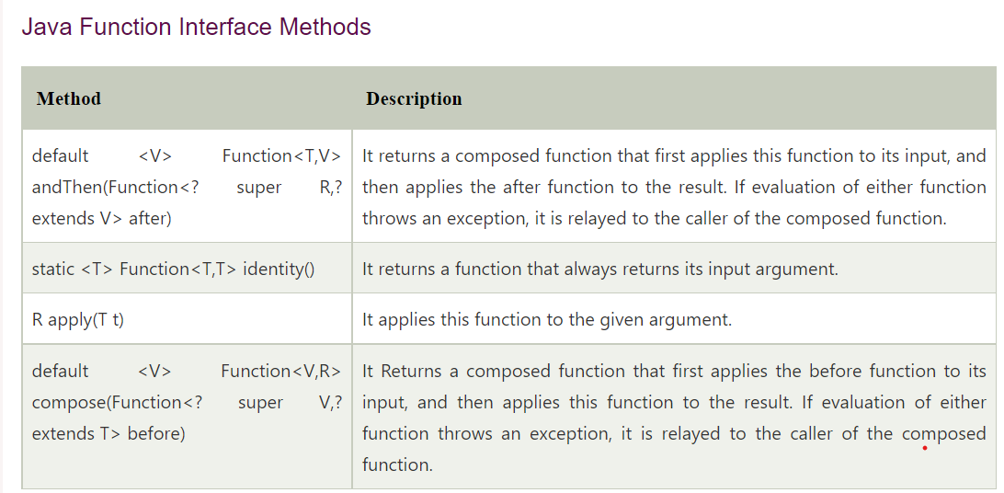
Java Function Interface

Slide 26
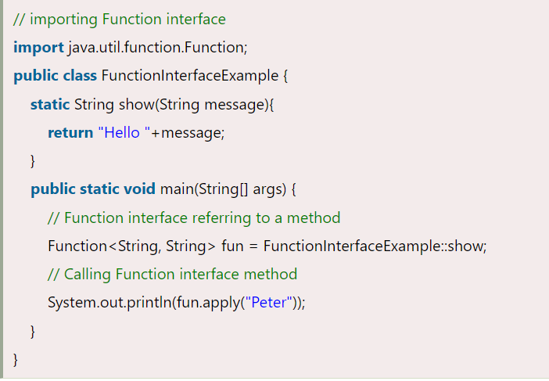
Java Function Interface Example

Slide 27
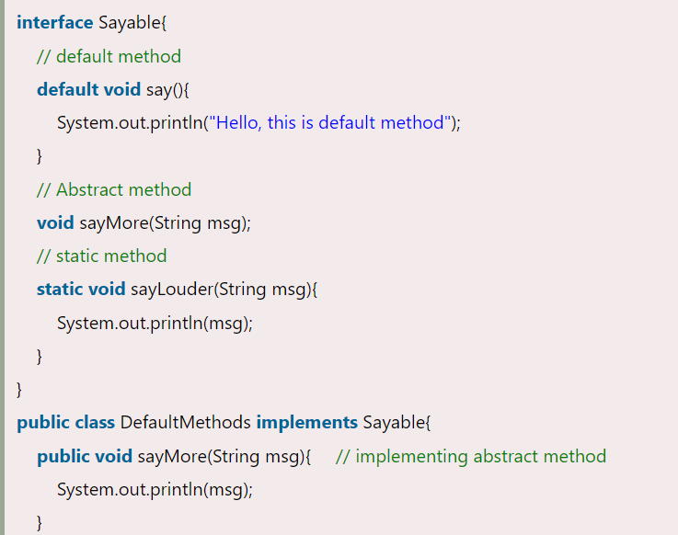

Slide 28
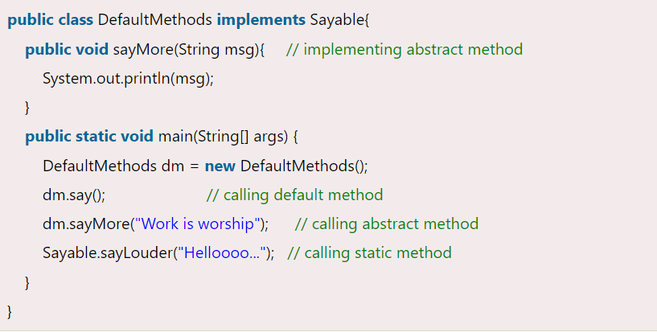

Slide 29
Java Method References
Method reference is used to refer method of functional interface. It is compact and easy form of lambda expression. Each time when you are using lambda expression to just referring a method, you can replace your lambda expression with method reference.

Slide 30
Types of Method References
Reference to a static method.
Reference to an instance method.
Reference to a constructor.

Slide 31
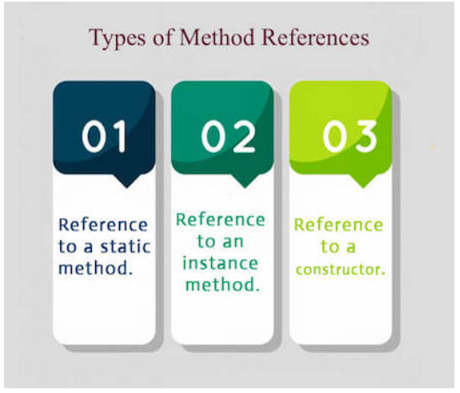

Slide 32

1) Reference to a Static Method

Slide 33

Reference to an Instance Method

Slide 34

Reference to a Constructor

Slide 35
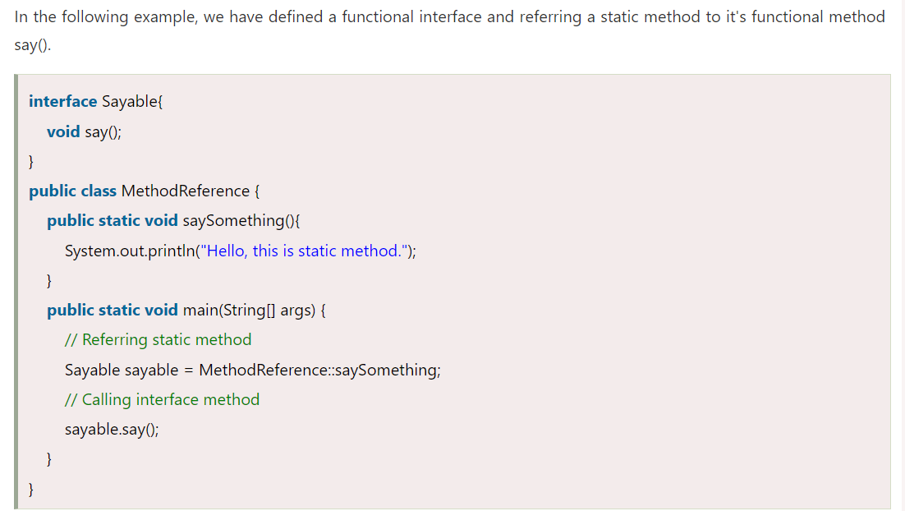

Slide 36
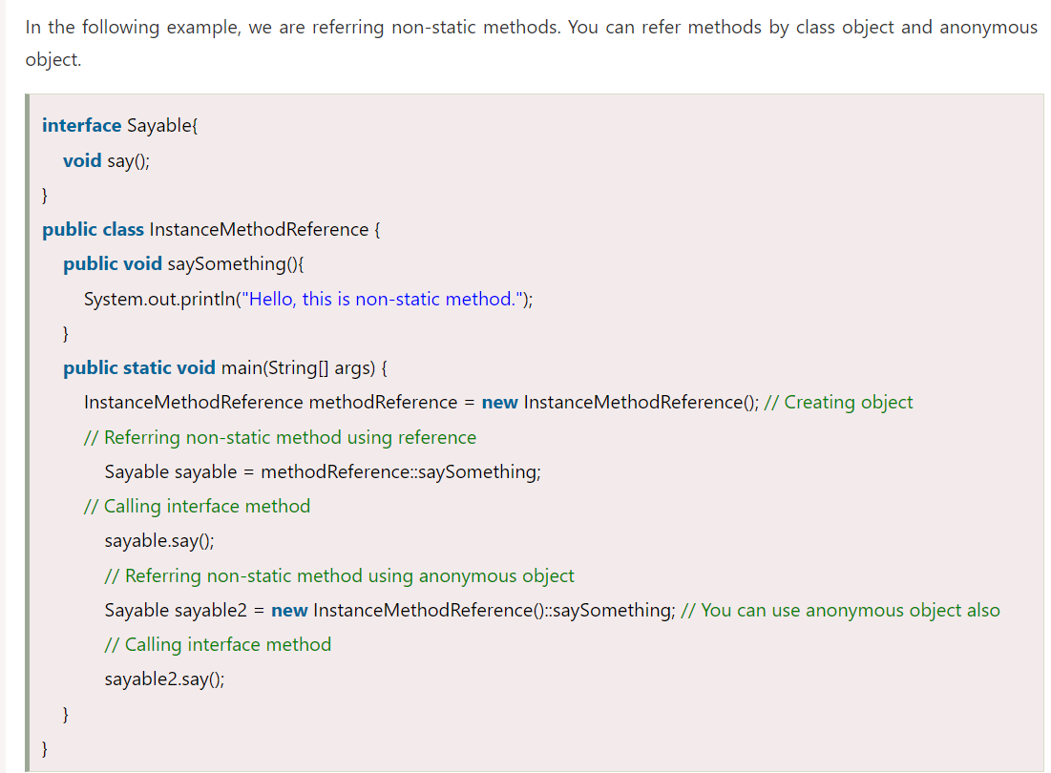

Slide 37
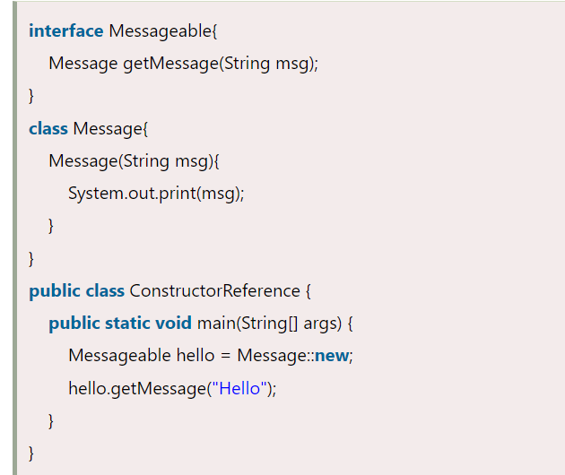

Slide 38
Java 8 Stream
Stream does not store elements. It simply conveys elements from a source such as a data structure, an array, or an I/O channel, through a pipeline of computational operations.
Stream is functional in nature. Operations performed on a stream does not modify it's source. For example, filtering a Stream obtained from a collection produces a new Stream without the filtered elements, rather than removing elements from the source collection.
Stream is lazy and evaluates code only when required.
The elements of a stream are only visited once during the life of a stream. Like an Iterator, a new stream must be generated to revisit the same elements of the source.

Slide 39
Java Stream Interface Methods

Slide 40
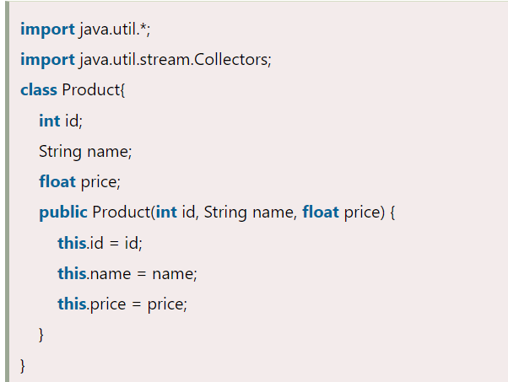
Java Stream Example: Filtering Collection by using Stream

Slide 41
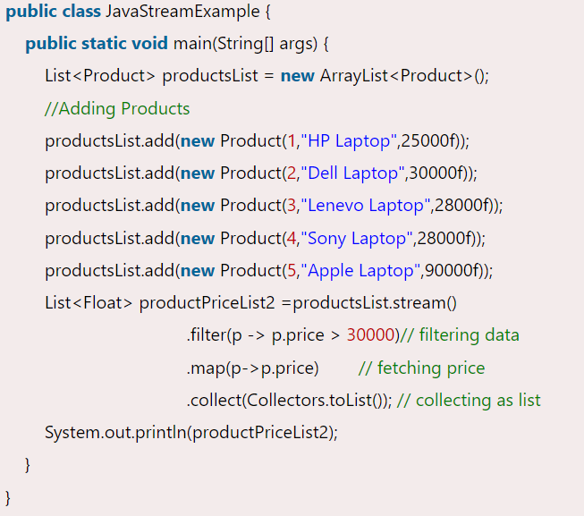

Slide 42
Collections vs Streams
Java Collections framework is used for storing and manipulating group of data. It is an in-memory data structure and every element in the collection should be computed before it can be added in the collections.

Slide 43
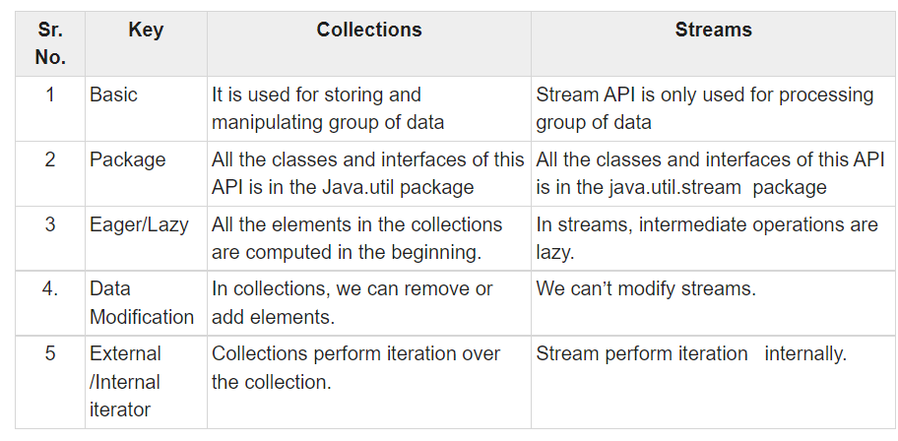

Slide 44
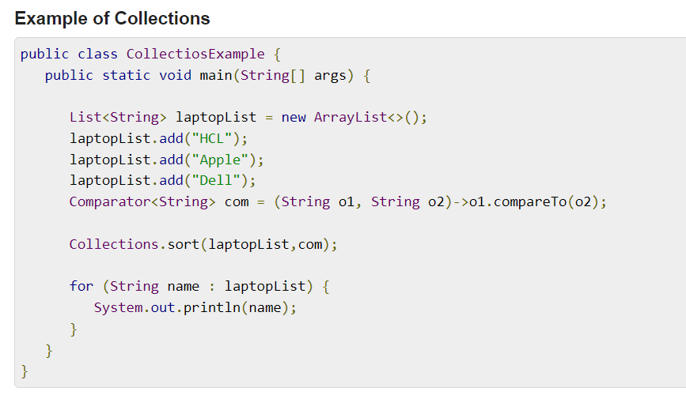

Slide 45
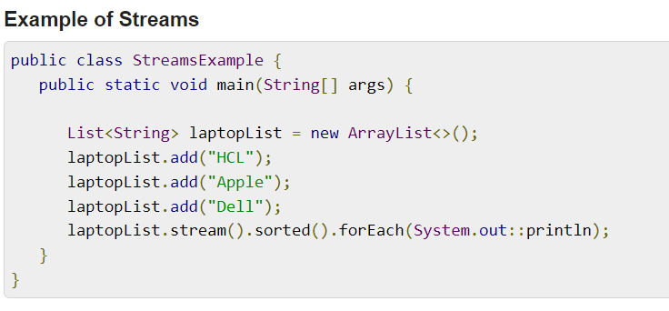

Slide 46
Java 9 Stream API Improvement
In Java 9, Stream API has improved and new methods are added to the Stream interface.

Slide 47
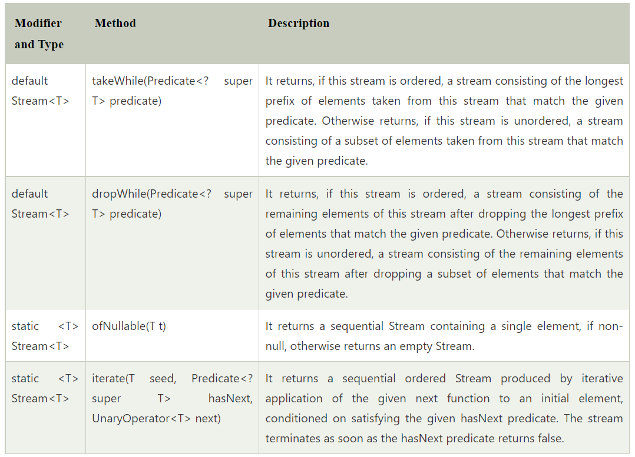

Slide 48
Java Stream takeWhile() Method
Stream takeWhile method takes each element that matches its predicate. It stops when it get unmatched element. It returns a subset of elements that contains all matched elements, other part of stream is discarded.

Slide 49
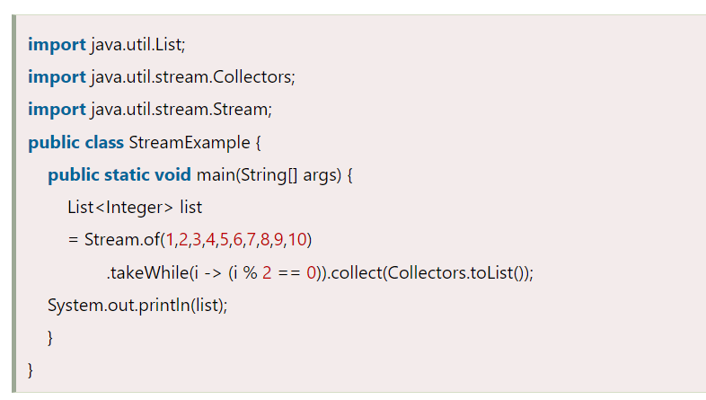
Java Stream takeWhile() Method Example

Slide 50
Java Stream dropWhile() Method
Ordered stream: It returns a stream that contains elements after dropping the elements that match the given predicate.
Unordered stream: It returns a stream that contains remaining elements of this stream after dropping a subset of elements that match the given predicate.

Slide 51
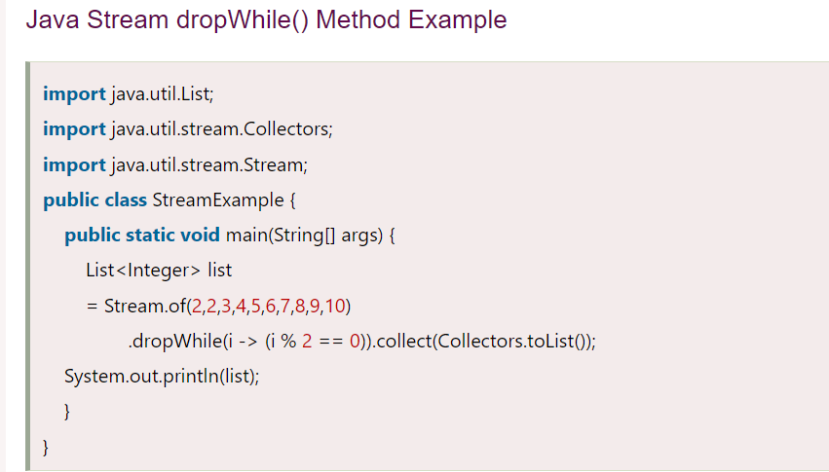

Slide 52
Java 9 Stream ofNullable Method
Stream ofNullable method returns a sequential stream that contains a single element, if non-null. Otherwise, it returns an empty stream.
It helps to handle null stream and NullPointerException.

Slide 53
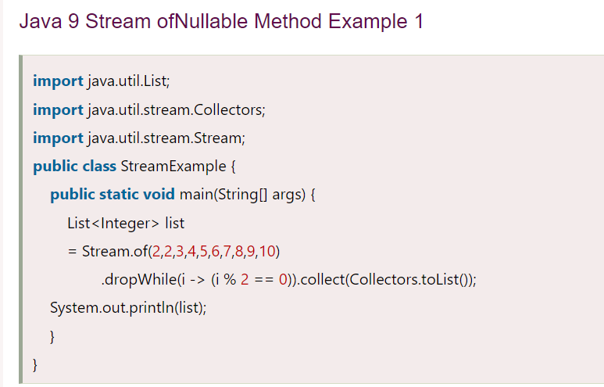

Slide 54
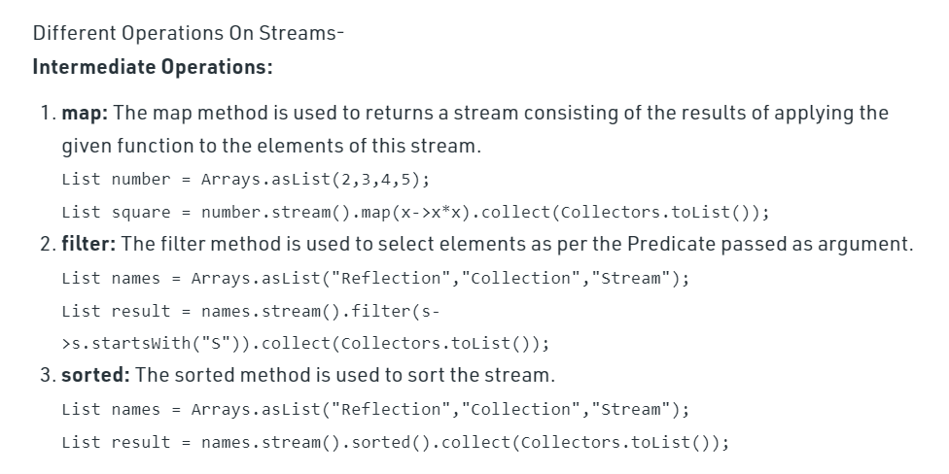
Stream In Java

Slide 55
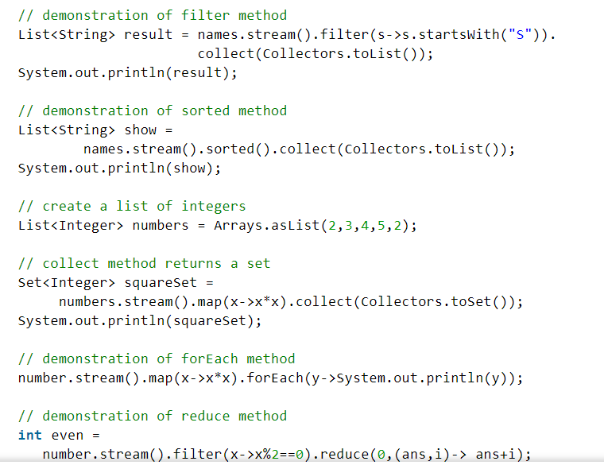

Slide 56
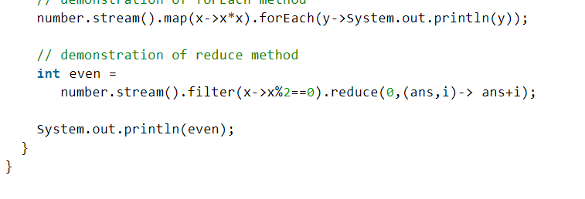

Slide 57
THANK YOU
NEEHARIKA

